Slide 1

Overview of Automotive cyber security
Notes:
Welcome to the first course from Autoronics where we will mainly discuss the basics of automotive electronics basically, we are from the automotive industry and as a part of our learning and to spread our knowledge we wanted to conduct this basic course via Autoronics services, during this course you are free to ask any questions or you can reach us with the mail id given ay the end of the training session

Slide 2
Overview to Automotive security
1.Domain specific automotive cyber attacks
2.Need of Automotive security
3.Automotive cyber security standards
- ISO 24343
- UN R 155
- UN R156
4.Basic properties of security
- CIA
5.Symmetric and Asymmetric algorithms
- AES , ECB CBC mode
- RSA
6.Detailed discussion about cryptography
7.Difference between SHE and HSM ()
8. Key management
9. Key exchange algorithm
- DH
10.Overview of AUTOSAR crypto stack
- SecOC
- CSM
- CRY
  - CRIF
  11. Secure boot
  12. Types of Attacks
  Sniffing/Eavesdrop
  Injection
  Denial Of Service
  Fuzzing
  Replay
  Impersonation
  13. Example in real scenario (use case)

Slide 3
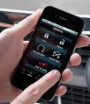




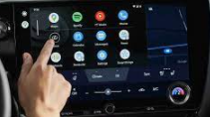
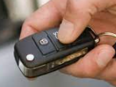
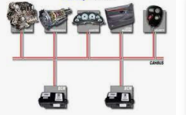
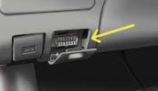
Automotive Cyber Attacks :

Slide 4
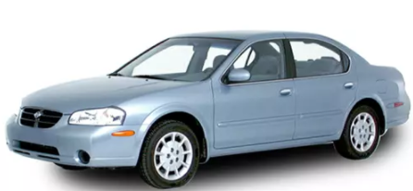
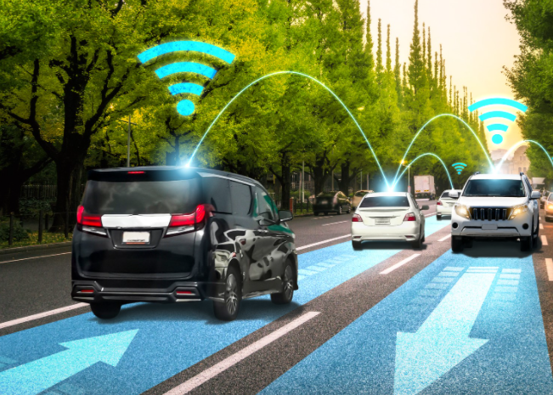
Need of Automotive security :
Do you know : Nowadays “Software on Wheel”
1980 :
No much connectivity : In fact 20% Software
2020 :
40-60% Software : 20 % Cars are connected
Risk of attack
Risk of attack

Slide 5
Need of Automotive security : Interesting information
The frequency of cyberattacks on cars increased 225 percent from 2018 to 2021.
Nearly 85% of attacks in 2021 were carried out remotely, outnumbering physical attacks four to one.
40% of attacks targeted back-end servers.
2021 saw 54.1% of attacks carried out by “Black Hat” (malicious) actors, up from 49.3% in 2020.
The top attack categories were data/privacy breach (38%), car theft/break-ins (27%), and control systems (20%).
Keyless entry and key fob attacks account for 50% of all vehicle thefts. Thieves only need to be close to the key fob for a Black Hat hacker to pick up and reproduce its signal

Slide 6





Hacks you might be knowing
(2002) VW, Audi, Porsche, Ford: 2002? Really?? If this started that far back, why did the national conversation wait another 15 years? These hackers, though, were actually being hired by aftermarket consumers to reprogram powertrain calibrations for more aggressive performance.
(2005) Chrysler, BMW, GM, Nissan: Thanks to a few Car Whisperers, Bluetooth could be hacked as you passed by, which allowed for listening to conversations or downloading contact information.
(2010) General Motors: This is possibly the most interesting hack since GM was afforded five, quiet years to fix a vulnerability where a bad actor could have “…basically [had] complete control of the car except the steering.”
(2013) Ford & Toyota: Our boys (Miller & Valasek) engage Andy Greenberg (formerly of Forbes) for the first time, and take a Ford and Toyota for a ride. This one is wired to the vehicle – not wireless – and they show the ability to truly futz with the overall system.
(2017) Hyundai: The Blue Link app contained a vulnerability where hackers could enter via insecure Wifi and obtain private user information and start cars remotely.
Courtesy : Forbes

Slide 7


Need of standard bodies
As shown in several publications, the number of attack vectors in connected cars and the automotive industry is significant. As more cybersecurity gaps are left open and unresolved, a sizable number of openings are left vulnerable for abuse. With the increasing call for the introduction and enforcement of cybersecurity standards for the industry, the combined ISO and SAE task force drafted and introduced ISO/SAE 21434, a set of guidelines for securing high-level processes in connected cars.

Slide 8
Automotive cyber security standards : ISO 21343
ISO 21434 provides a guideline for ensuring the cybersecurity of road vehicle electronic systems. It was developed to ensure that OEMs and suppliers take cybersecurity into account at every step of the product lifecycle, from the concept phase all the way to retirement. To expand on that, ISO 21434 provides the terminology, objectives, requirements, and guidelines that organizations need in order to:
Define cybersecurity policies and processes
Analyze, identify, and manage cybersecurity risks
Champion a ‘security by design’ or cybersecurity culture within the organization
ISO 21434 applies to all the software included in vehicles as well as electronic systems and components, and last but not least, the hardware as well. The overall goal of the standard is to provide a comprehensive guideline for automotive developers which will help them cover cybersecurity topics throughout the whole development lifecycle, and make sure that the entire supplier chain is covered, too.

Slide 9
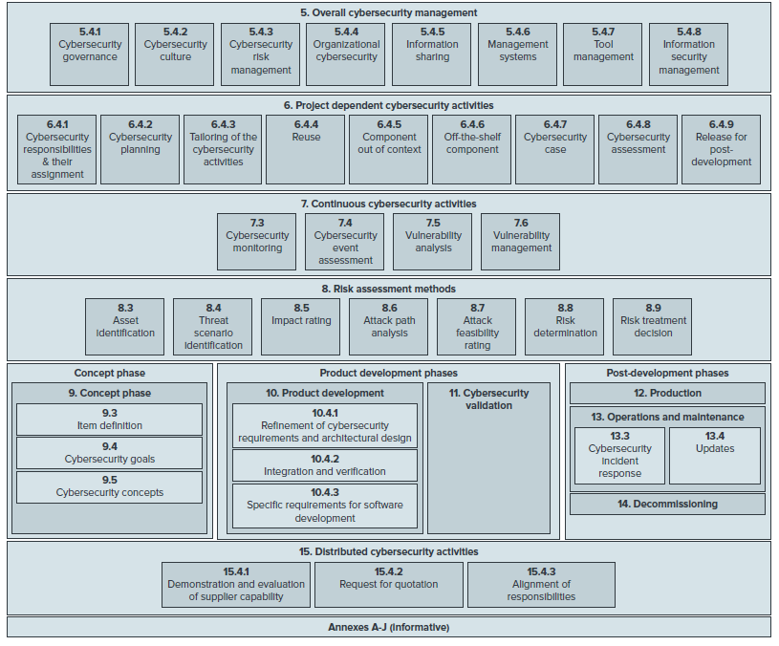
Automotive cyber security standards : Key elements in ISO 21434
Implementing Cyber security in the management culture
Define cybersecurity actions at Project planning
Cybersecurity control and Monitoring
Risk Assessment in detail
Cyber security implementation in product development, serial life
Cyber security testing
Cyber security in lifecycle

Slide 10
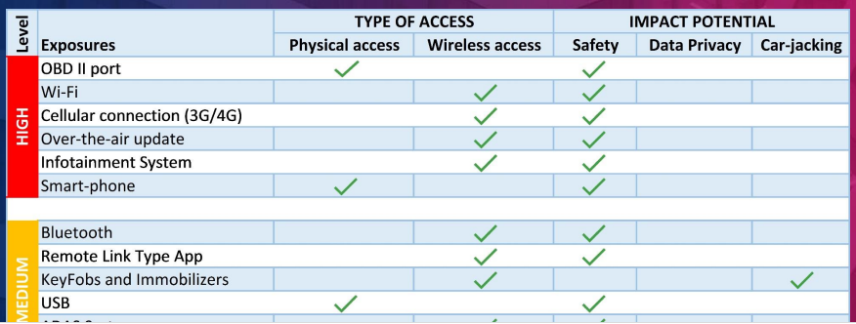
Automotive cyber security standards : TARA
Threat Analysis and Risk Assessment (TARA).
The objective of conducting a TARA is self-explanatory, it aims to break down your system into threats and assessing the risks from the threats discovered. Conducting a TARA is a crucial step after asset identification. Afterwards, begin funneling your selected assets and features down a TARA pipeline in order to generate risk documentation of each asset. As you can imagine corporations will have thousands of assets each with their own TARA, maintaining such documentation in a secure way is a topic for another time. Upon completion, three phases will follow.
1. Establishing cybersecurity goals
2. Developing strategies within the cybersecurity concept to tackle goals
3. Establishing what functional cybersecurity requirements will need to comply with your concept
A TARA will help drive all reasoning for cybersecurity initiatives within the organization. Threat Analysis starts from the inception of the cybersecurity plan. Organizations will need to draw inspiration from the cybersecurity plan in order to produce a document yielding a list of threats associated to features and assets identified throughout the process. This information will then be utilized for threat analysis.

Slide 11
Automotive cyber security standards
UN R 155

Slide 12
Automotive cyber security standards
UN R 156

Slide 13
Automotive cyber security standards
UN R 156

Slide 14
Basic concepts of security(CIA)
C - Confidentiality
I - Integrity
A - Availability
Confidentiality
  Information / Data is only available to authorized person
  Example: Encryption and decryption
  The data can be encrypted by the sender side and can be decrypted from the receiver side by using authorized key. So we ensure that the data is not visible or by other unauthorized users

Slide 15
Integrity
  Ensure that the Information/ data is not modified by unauthorized person
  Example : Hash , MAC.
  Calculate Hash for the actual data and send the calculated hash along with actual data to the receiver. On the receiver side the hash is calculated again and compared using the calculated hash sent by sender. If the hash matches we ensure that the data is not modified in the communication medium.

Slide 16
Availability
  Ensure that the data is available for the user at the right time
Example: Make the CAN bus busy so that the CAN network will not be available for the user.

Slide 17
Symmetric and Asymmetric algorithms
AES
ECB
CBC mode
RSA

Slide 18
Cryptography

Slide 19
Overview of an ECU Software architecture
Difference between SHE and HSM

Slide 20
Key management

Slide 21
Key exchange algorithm
DH

Slide 22
Overview of AUTOSAR crypto stack
SecOC
CSM
CRY
  CRIF

Slide 23
Secure boot

Slide 24
Types of Attacks
  Injection
  Sniffing/Eavesdrop
  Denial Of Service
  Fuzzing
  Replay
  Impersonation

Slide 25
Sniffing/Eavesdrop

Slide 26
Injection

Slide 27
Denial Of Service

Slide 28
Fuzzing

Slide 29
Replay

Slide 30
Impersonation

Slide 31
  Example in real scenario (use case)

Slide 32
Keep in touch with us!
autoronicsservices@gmail.com
linkedin.com/in/autoronics-services

